Slide 1
The AI market: models, vendors, and buy, rent or build
Which model and supplier, where does our data go, and what will it cost to run?
Leading with AI | Session 6 of the 15 (Sessions 0 to 14)
KLAi Professional Learning | Jotham Martin Wambi
Notes:
Welcome back. In Session 5 we opened up the chatbot: it writes one likely word at a time, and fluent is not the same as true. Today we step back from how it writes to who sells it to you. Every leader who buys AI meets the same three questions: which model and which supplier, where does our data go, and what will it cost to run?
We start with a ruling in Kampala, map the makers, compare three routes, tour six industries, and watch two assistants answer the same customer complaint. Then you choose a route for each entry in your AI Opportunity Portfolio.

Slide 2



What you will leave with today
By the end of today you will have
Say who makes AI models, and tell a hosted model from an open-weights one, in plain words
Choose between renting, hosting and building on a partner with four questions: data and the law, cost per use, lock-in, vendor survival
Add a route, a data note and an exit plan to each entry in your AI Opportunity Portfolio
Notes:
That question gives you three things to leave with. You will be able to say who makes the models you hear about, and tell a hosted model from an open-weights one in plain words. You will choose between renting, hosting and building on a partner by asking four questions: where the data goes and what the law says, the cost of each use, how hard it is to leave, and whether the supplier will last.
And each portfolio entry will carry a route, a data note and an exit plan.

Slide 3
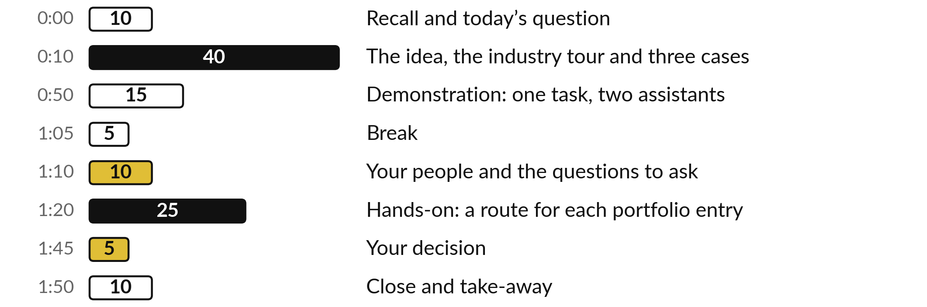
Your two hours: the market, the routes,
a recorded test, then your own portfolio
I show a recorded test of two assistants. You choose a route for your own portfolio entries.
Notes:
Here is how the two hours run. Ten minutes to recall Session 5 and meet today’s question. Forty minutes on the market: who makes the models, the three routes and the four questions that decide between them, then six industries and three real cases. Fifteen minutes on a recorded test of two assistants on the same task.
A five-minute break. Ten minutes on your people and the questions for a vendor. Then twenty-five minutes on your own portfolio, five on your decision, and ten to close.

Slide 4
Three questions from last time
1. In Session 5, how does a chatbot write its answer?
2. Why can a fluent answer still be wrong?
3. Where does a chatbot shine, and where does it tend to invent?
Answer aloud first. Then we check together.
Notes:
Three quick questions from Session 5. Answer aloud first, and then we check together.
Question one. In Session 5, how does a chatbot write its answer? Take a moment.
A good answer is this. One word at a time, each time choosing a likely next word, like phone autocomplete trained on a vast library.
Question two. Why can a fluent answer still be wrong? Say it to yourself first.
A good answer is this. Nothing inside the chatbot checks the facts. It writes what is likely, and a likely sentence can be false, such as an invented reference.
Question three. Where does a chatbot shine, and where does it tend to invent? Think about your own work as you answer.
A good answer is this. It shines at drafts, summaries and first answers. It tends to invent citations, figures, policies and names, so a person checks those.
If an answer was missing, last session’s take-away sheet has it.

Slide 5
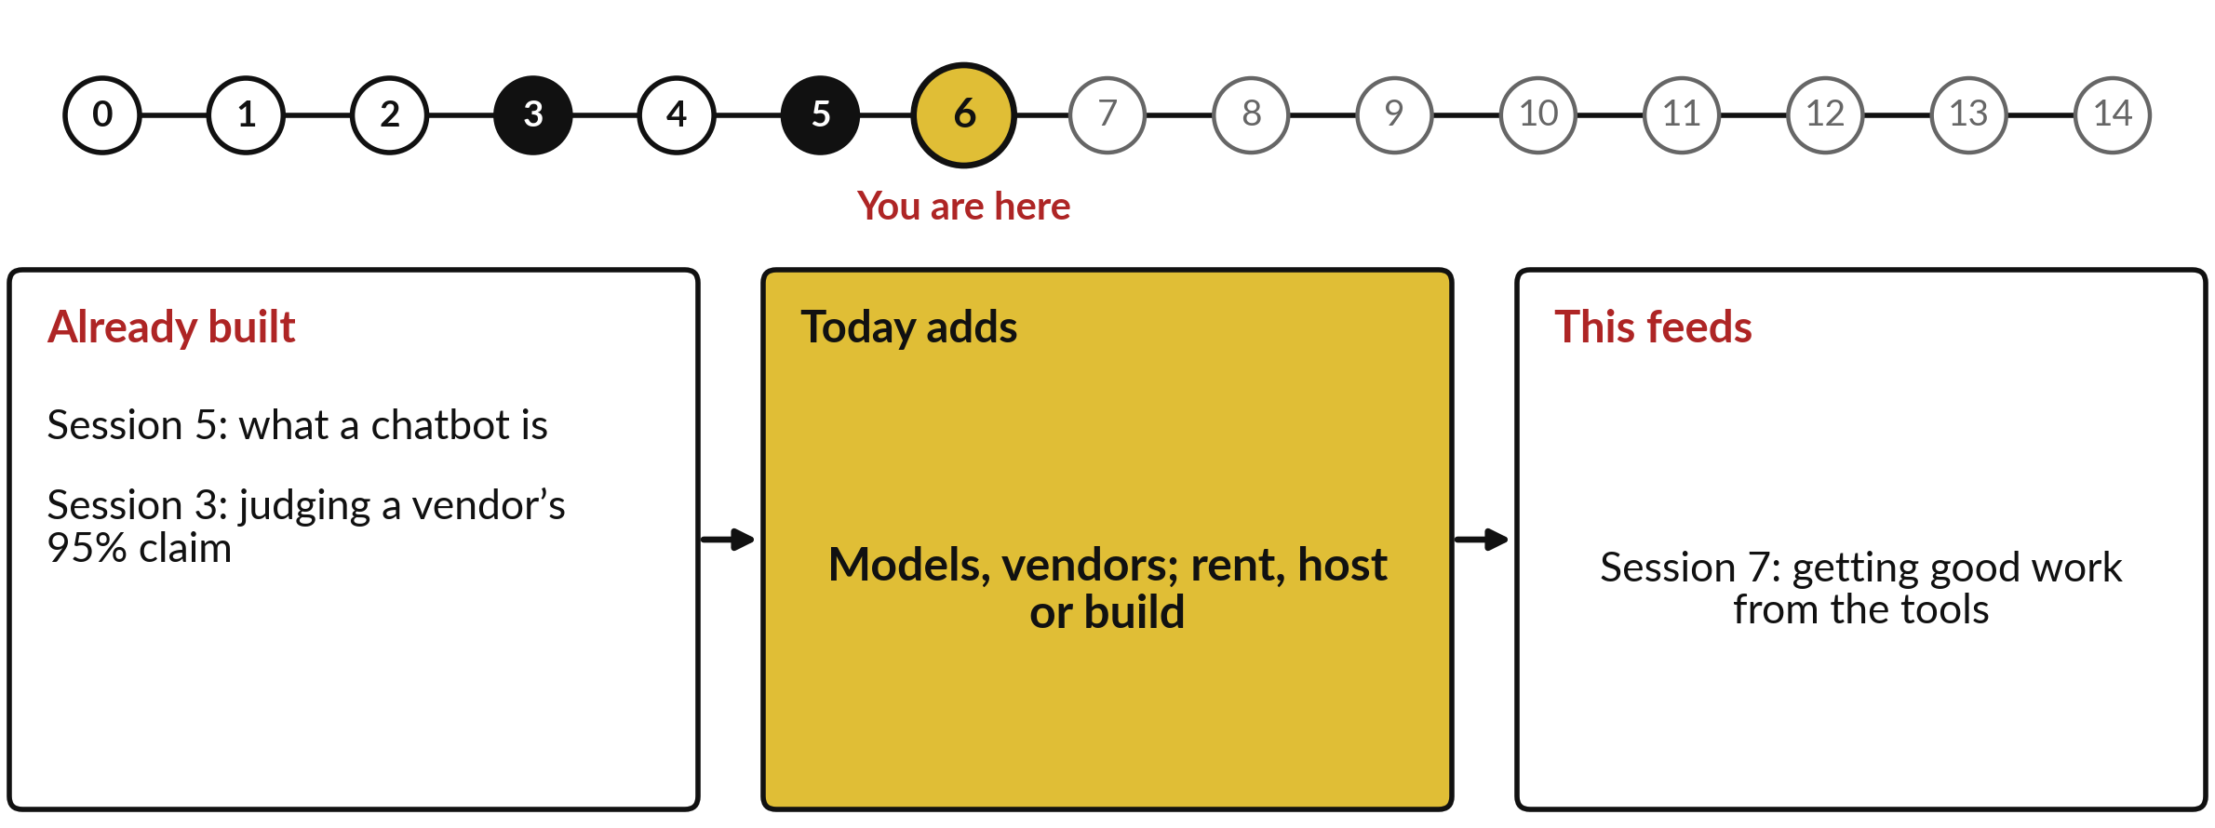
What today builds on, and where it leads
Each session is built on the ones before it.
Notes:
The dots along the top are the fifteen sessions, from the map at Session 0 to your plan at Session 14; the gold one is today.
Today uses what a chatbot is from Session 5 and judging a vendor’s 95% claim from Session 3.
It adds models, vendors; rent, host or build.
Session 7: getting good work from the tools.

Slide 6
Words we use today
Word | What it means
Hosted model | A model that runs on the vendor’s computers. You send your text over the internet and pay to use it.
Open weights | A model whose learned numbers can be downloaded and run on computers you choose, under a licence.
Fine-tuning | Further training of an existing model on your own examples, so it fits your language or your task.
Lock-in | When leaving a supplier would cost so much time and money that you are stuck with it.
Benchmark | A fixed public test with an answer key, used to compare models. It is someone else’s test.
Notes:
Five words for today. We use every one of them before the end of the session.
Hosted model. A model that runs on the vendor’s computers. You send your text over the internet and pay to use it.
Open weights. A model whose learned numbers can be downloaded and run on computers you choose, under a licence.
Fine-tuning. Further training of an existing model on your own examples, so it fits your language or your task.
Lock-in. When leaving a supplier would cost so much time and money that you are stuck with it.
Benchmark. A fixed public test with an answer key, used to compare models. It is someone else’s test.

Slide 7
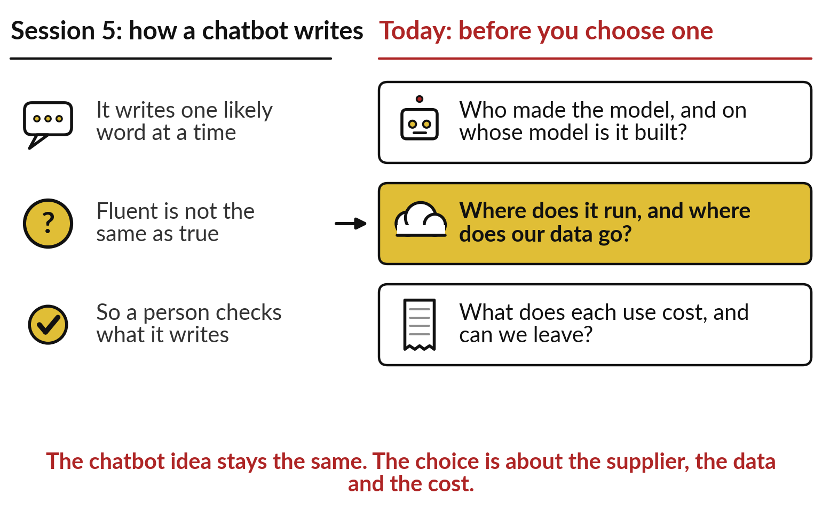
The chatbot works the same whoever sells
it; the supplier, the data and the cost differ
Before you choose a chatbot, ask who made it, where it runs and what it costs.
Session 5: it writes likely words, and a person checks.
Today: the supplier, the data and the cost.
Notes:
Those five words belong to one decision, and it starts from what you know. In Session 5 we saw that a chatbot writes one likely word at a time, that fluent is not the same as true, and so a person checks what it writes. On the left is that picture.
On the right are the questions a leader asks before choosing one. Who made the model, and on whose model is it built?
Where does it run, and where does our customers’ data go?
What does each use cost, and could we leave?
The chatbot idea stays the same whichever you choose. The middle question has already reached a Ugandan regulator.

Slide 8
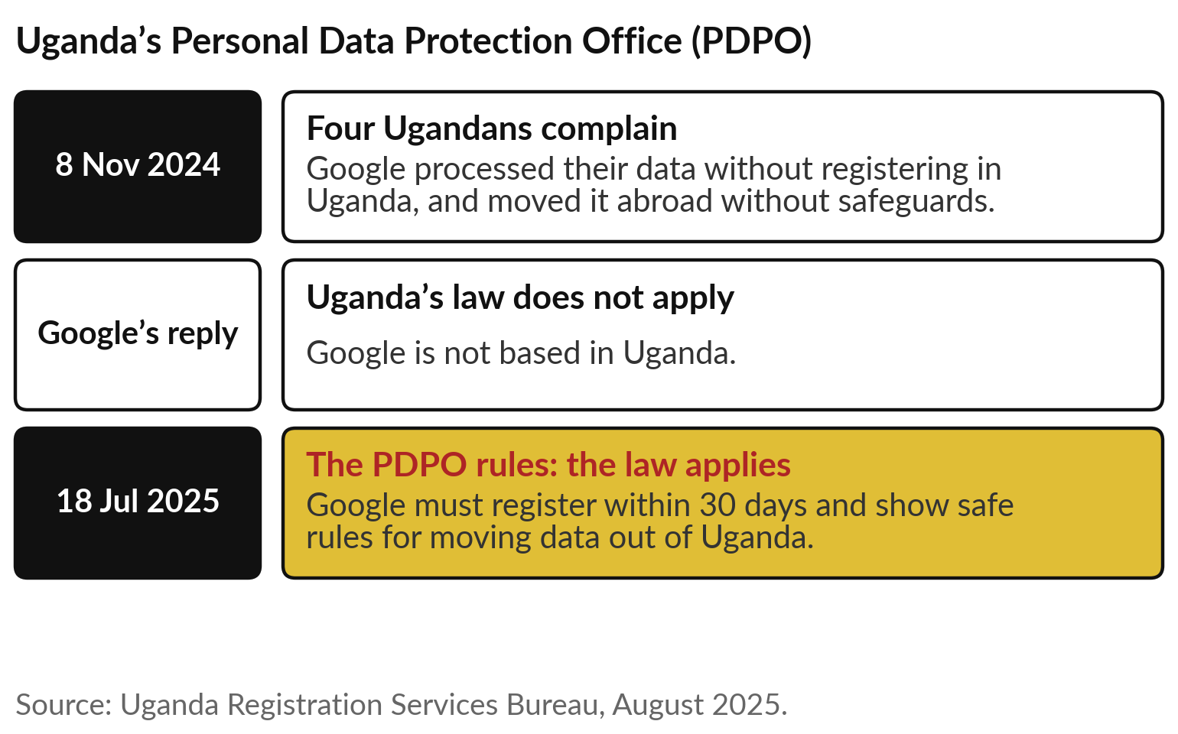
In July 2025 Uganda’s data protection
office ruled that its law applies to Google
Which model and supplier, where does our data go, and what will it cost to run? That is today’s question.
A foreign supplier still answers to Uganda’s law.
Your AI supplier handles your customers’ data too.
Notes:
In November 2024 four Ugandans complained to the Personal Data Protection Office, the PDPO, that Google processed their data without registering in Uganda and moved it abroad without safeguards. Google replied that Uganda’s law did not apply, because it is not based here. In July 2025 the PDPO disagreed.
It found Google to be a data controller under Ugandan law, meaning an organisation that decides how personal data is used, ordered it to register within 30 days, and to show safe rules for moving data out of the country. No compensation was reported, and an appeal was possible.
It is not an AI case, but every AI supplier you rent from handles your customers’ data in the same way.

Slide 9
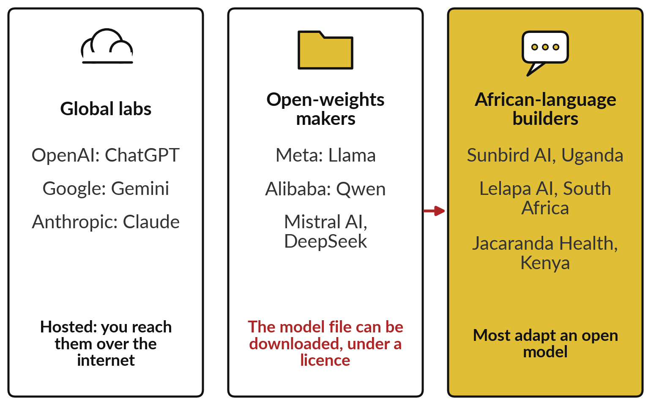
A few global labs, the open-weights makers
and African-language builders make the models
Most African builders start from someone else’s open model.
Global labs rent you their model as a service.
Open-weights makers let you download theirs.
African builders adapt one for local languages.
Notes:
Which model, then?
Start with who makes them. On the left are a few global labs: OpenAI makes ChatGPT, Google makes Gemini, Anthropic makes Claude. You reach their models over the internet, and the models stay with them. In the middle are makers who publish the model itself for anyone to download, under a licence: Meta’s Llama, Alibaba’s Qwen, Mistral AI and DeepSeek.
Some makers do both; Google also publishes open models. On the right are builders of models for African languages: Sunbird AI here in Uganda, Lelapa AI in South Africa, Jacaranda Health in Kenya. Follow the red arrow. Most of them did not start from nothing. They built on an open model.

Slide 10
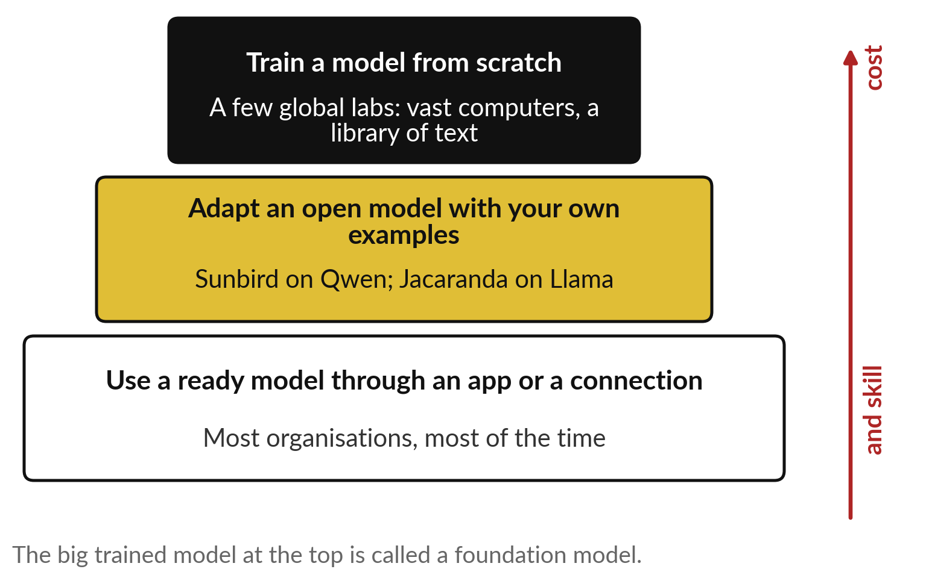
Most organisations never train a model; they
use one, or adapt one someone else trained
Training from scratch is for a few labs. Adapting or using is for everyone else.
The big trained model is a foundation model.
Adapting it with your examples is fine-tuning.
Most of you will use a ready model.
Notes:
They built on one because training a model from scratch is a project for very few. It takes vast computers and a library of text, the autocomplete trained on a library from Session 5; the industry calls that stage pretraining. The big general model that comes out is called a foundation model, because others build on it.
One step down, an organisation takes an open model and trains it further on its own examples. That is fine-tuning, one of our words. Sunbird did it with Alibaba’s Qwen for Ugandan languages; Jacaranda did it with Meta’s Llama for Kiswahili health messages. At the bottom, where most organisations sit most of the time, you use a ready model through an app or a connection. Cost and skill rise as you go up.

Slide 11
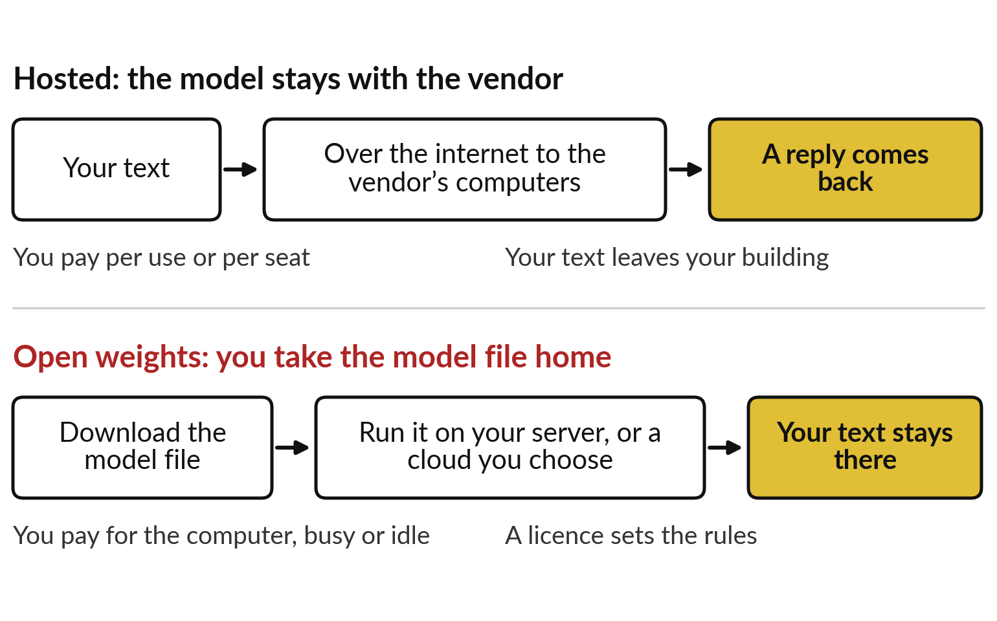
A hosted model stays with the vendor; an
open-weights model is a file you take home
Hosted: your text travels to the model. Open weights: the model comes to your computers.
Hosting is like a taxi: pay per ride.
Open weights is like a car you keep.
Free to download can still mean limits on use.
Notes:
Using a ready model still leaves a choice: whose computers does it run on?
A hosted model stays on the vendor’s computers. Your text travels over the internet, the model answers there, and the reply comes back. You pay per use or per staff seat, and your text leaves your building, like a taxi you pay for each ride and never own.
An open-weights model is a file you download and run on your own server, or on a cloud you choose. Your text stays where you put it, and you pay for the computer whether it is busy or idle, like a car you keep. Open weights means free to download, while the licence may still limit use.
The Open Source Initiative says Meta’s Llama licence does not meet its open source definition, for that reason.

Slide 12
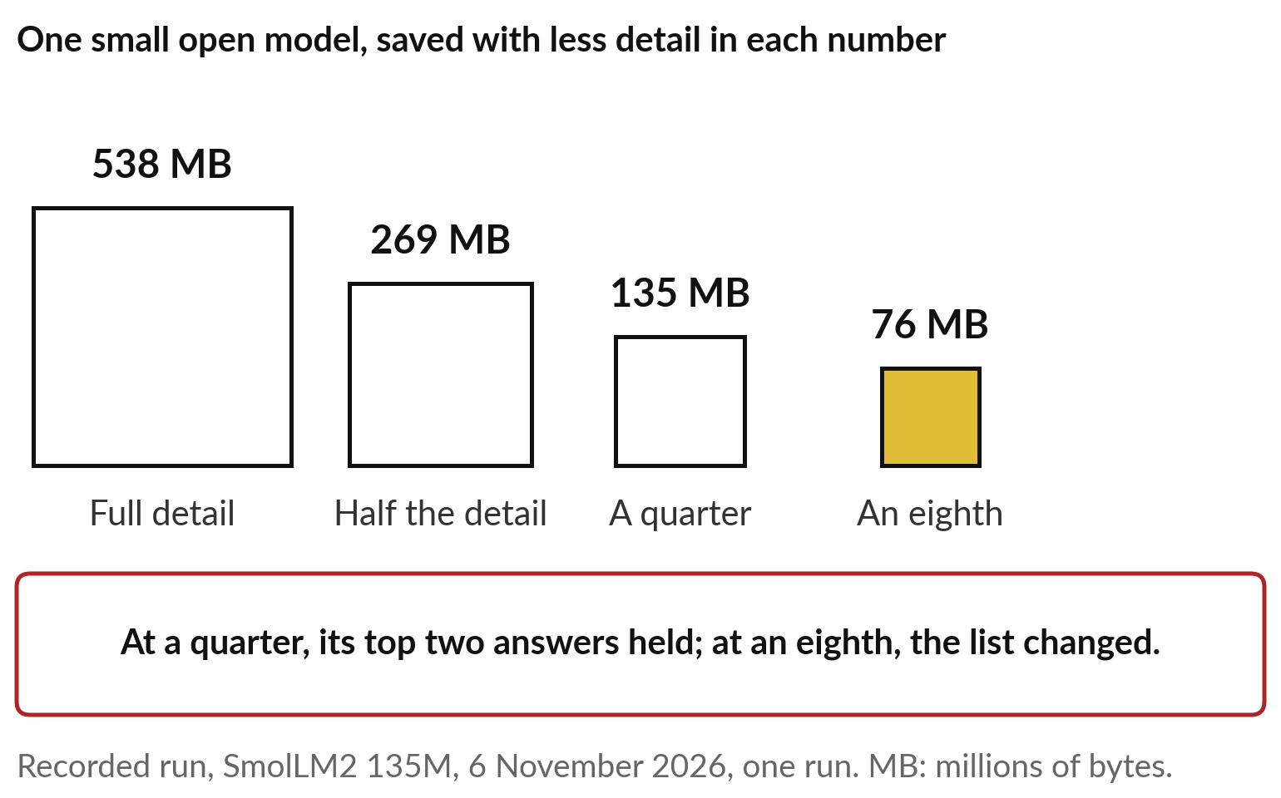
Size decides where an open model can run: one
small model shrank from 538 to 76 megabytes
A smaller file needs a cheaper computer, and may answer worse.
The industry calls the shrinking quantisation.
One run: it shows the trade and proves no more.
Test a shrunk model on your own work.
Notes:
The file has a size, and that decides what computer you need, and so what hosting costs. This is a recorded run from 6 November 2026 on a very small open model, SmolLM2, with 135 million learned numbers. Saved in full detail, the file is 538 megabytes. Keep half the detail in each number and it is 269; a quarter, 135; an eighth, 76, a little more than an eighth because of labels the file must carry.
The industry calls this shrinking quantisation. Then I asked each version to continue, the capital city of Uganda is. At a quarter of the size its top two next words held. At an eighth the list changed. It was one run, so it shows the trade and proves no more.
Smaller is cheaper to run, and you test it before you trust it.

Slide 13
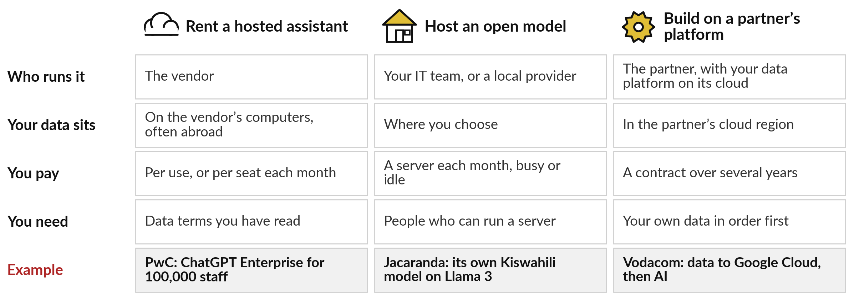
You can rent a hosted assistant, host an
open model, or build on a partner’s platform
PwC, Jacaranda and Vodacom each took a different route.
Notes:
That gives three routes. Renting a hosted assistant: the vendor runs it, your data sits on its computers, often abroad, and you pay per use or per seat. PwC announced in 2024 that more than 100,000 of its US and UK staff would get ChatGPT Enterprise this way.
Hosting an open model: your IT team or a local provider runs it, the data sits where you choose, and you pay for a server each month. You need people who can run it. Jacaranda Health built its own Kiswahili model on Llama 3. Building on a partner’s platform: you move your data onto a big cloud and use its AI, under a contract of several years, and your own data must be in order first.
Vodacom announced that route with Google Cloud in November 2025, with no results yet.

Slide 14
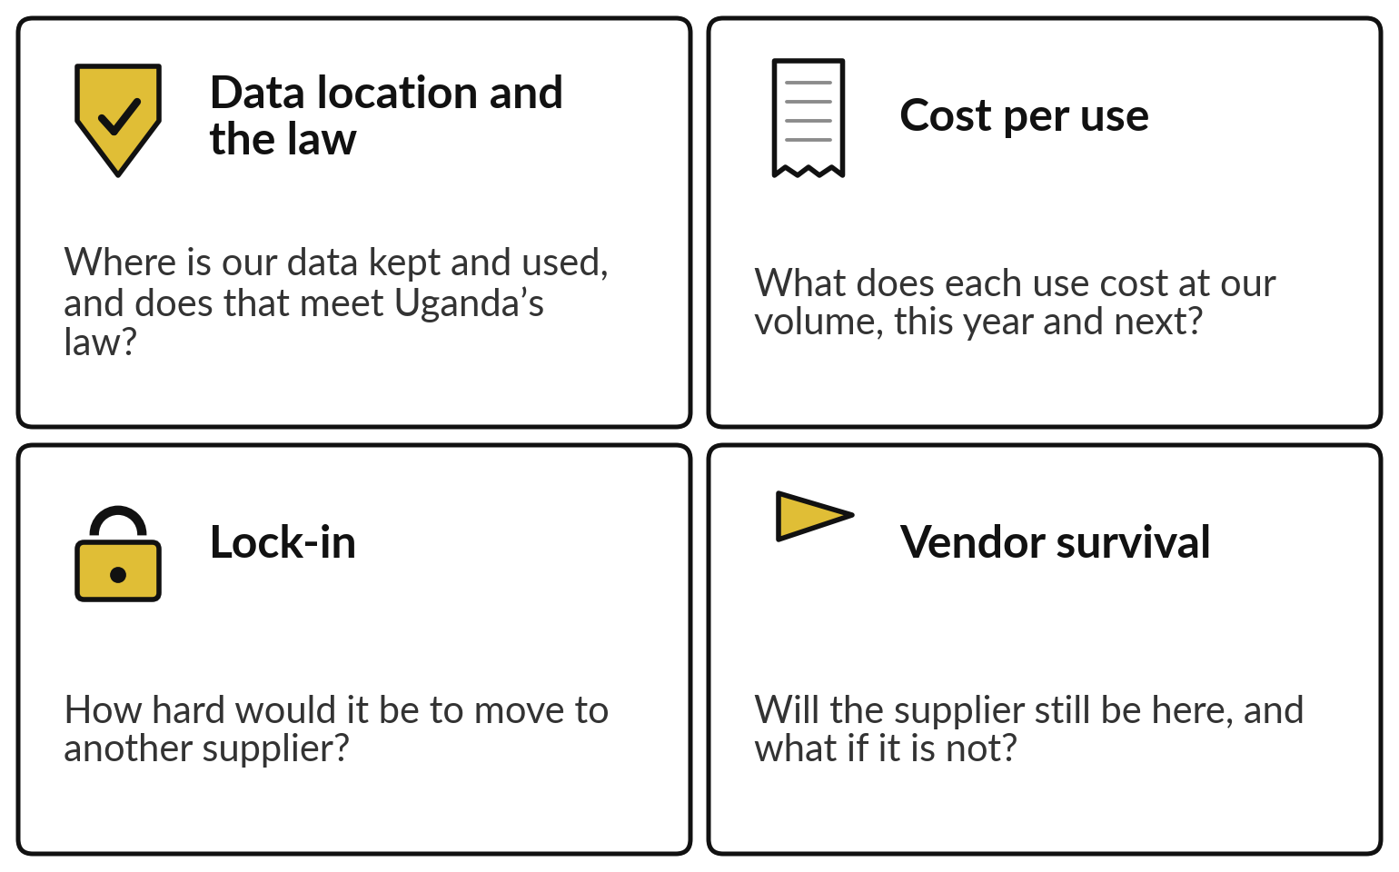
Four questions decide the route: data and the
law, cost per use, lock-in, and vendor survival
Ask all four before you sign, and write the answers down.
The answers differ by use.
One company can rent for one use and host for another.
Your portfolio is where you decide, use by use.
Notes:
Four questions choose between the routes. Data location and the law: where is our data kept and used, and does that meet Uganda’s law?
Cost per use: what does each use cost at our volume, this year and next?
Lock-in: how hard would it be to move to another supplier?
And vendor survival: will the supplier still be here, and what happens to us if it is not?
The answers depend on the use. Drafting a public product description and summarising staff salary files can sit on different routes in the same company. So you decide use by use, which is what your portfolio is for. We take the questions one at a time, starting with the data.

Slide 15
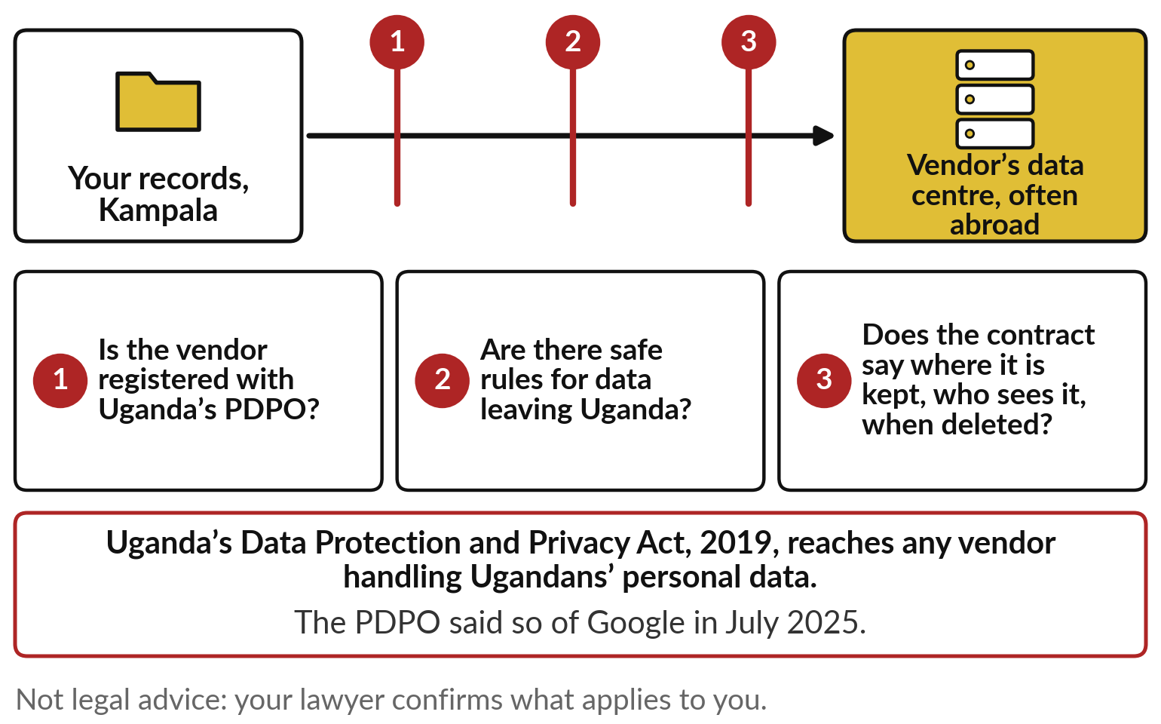
Uganda’s law follows your data
abroad, wherever the vendor sits
Three checks on the way out: registration, safe transfer, a clear contract.
Orange has OpenAI models hosted in Europe.
Some vendors let you choose the region.
Your lawyer confirms the details.
Notes:
Start with the data. When staff paste a customer’s complaint into a hosted assistant, that text leaves your records in Kampala and travels to a data centre, often in Europe or the United States. Uganda’s Data Protection and Privacy Act of 2019 does not stop at the border.
As the PDPO told Google, a foreign company handling Ugandans’ personal data is covered. So put three checks on that arrow. Is the vendor registered with the PDPO?
Are there safe rules for data leaving Uganda?
And does the contract say where the data is kept, who may see it, and when it is deleted?
Some vendors offer a choice of region; Orange, for example, has OpenAI models hosted in European data centres. This is not legal advice; your lawyer confirms the details.

Slide 16
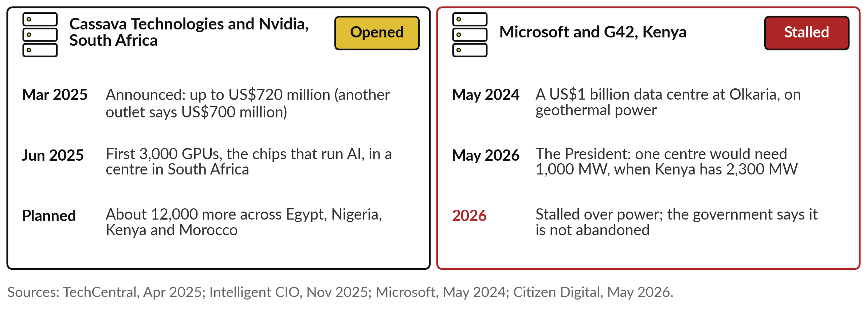
Cassava’s AI data centre opened in South Africa;
a US$1 billion one in Kenya stalled over power
No Ugandan site has been announced, so most of your AI runs abroad for now.
Notes:
The data centre is so often abroad because Africa still has few of the computers that run AI, though two stories show that changing. Cassava Technologies and Nvidia announced an AI factory in March 2025, a plan of up to 720 million dollars; another outlet says 700 million.
By June 2025 the first 3,000 GPUs, the chips that run AI, had arrived at a new centre in South Africa, with about 12,000 more planned across Egypt, Nigeria, Kenya and Morocco. In Kenya, Microsoft and G42 announced a one billion dollar data centre on geothermal power in 2024.
In May 2026 the President said one centre would need 1,000 megawatts when Kenya has 2,300. It has stalled; the government says it is not abandoned. The second question is cost.

Slide 17
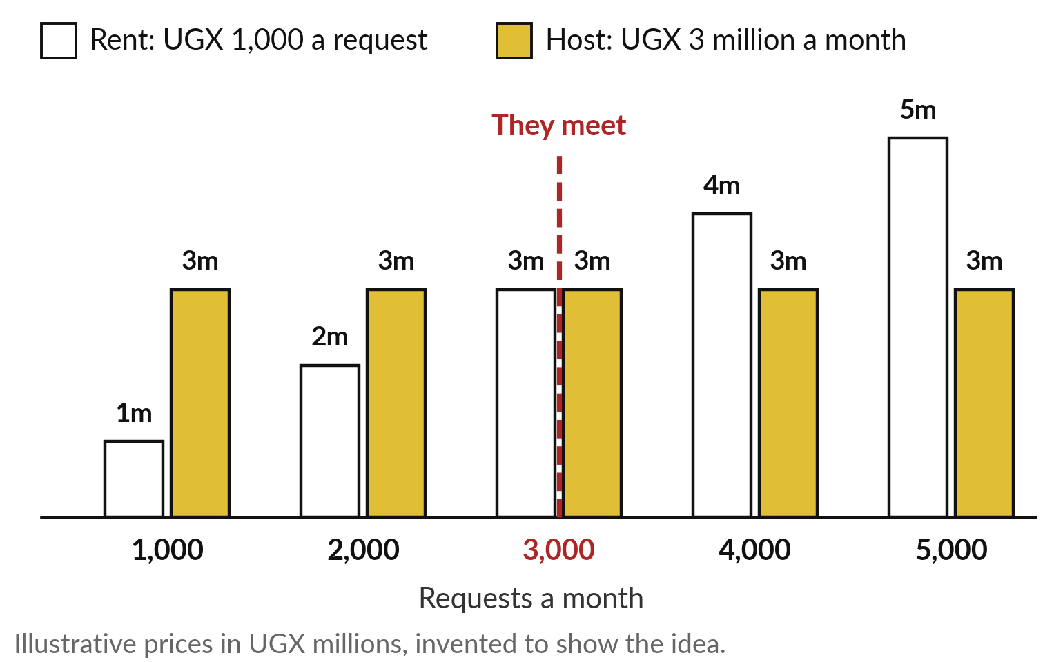
Renting is cheaper at low volume,
and hosting at high volume
Renting grows with every request. Hosting costs the same, busy or idle.
Here they meet at 3,000 requests a month.
Finance calls that the break-even volume.
Count the staff to run a server too.
Notes:
Cost depends on how much you use it. Take Nile Valley Foods, our fictional distributor, drafting replies with a model. The prices are invented to show the idea, because real prices change often. Renting costs UGX 1,000 a request. Hosting means a server at UGX 3 million a month, busy or idle.
At 1,000 requests a month, renting costs one million and hosting three, so rent wins. At 5,000 requests renting costs five million and hosting still three, so hosting wins. The bars meet at 3,000 requests a month, which finance people call the break-even volume. Below it, rent. Well above it, hosting may pay, once you add the people who keep a server running.
Ask your team for the monthly volume before anyone argues about routes.

Slide 18
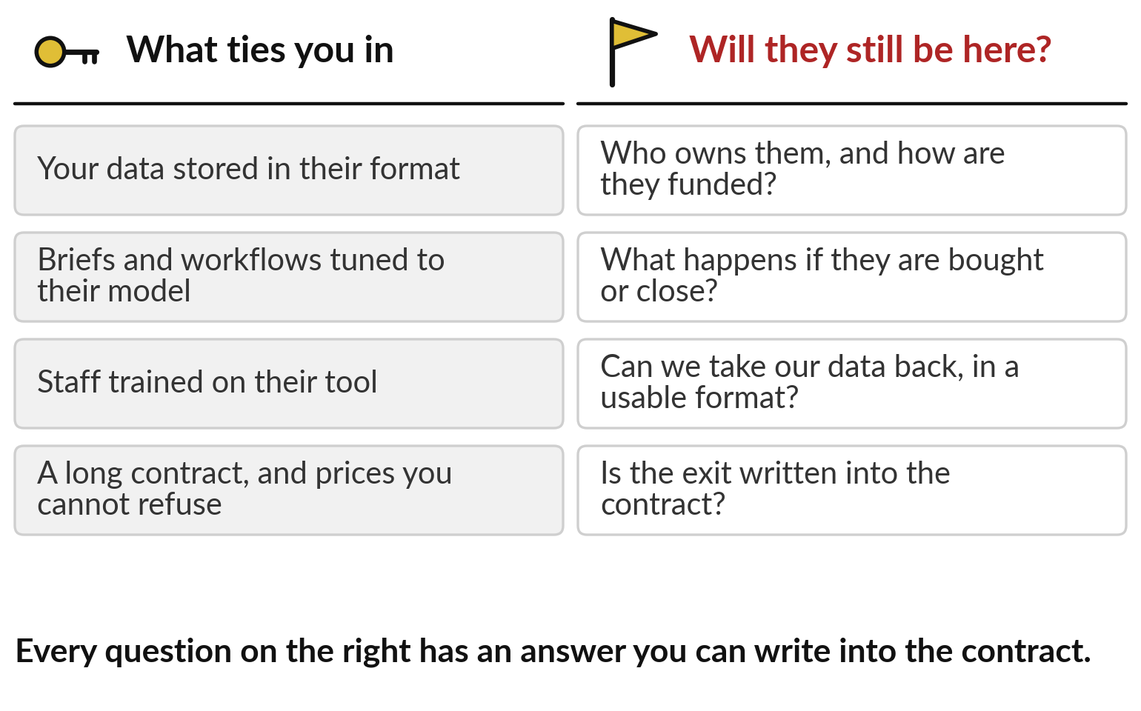
Plan how you would leave a
supplier on the day you sign
The longer you build on one supplier, the more it costs to leave.
Spreading work across vendors lowers the risk.
Absa uses Microsoft, Amazon and Salesforce at once.
Notes:
The third question, lock-in, is harder to price. On the left is what ties you in: your data stored in their format, briefs and workflows tuned to their model, staff trained on their tool, and a long contract with prices you cannot refuse. None is wrong on its own, and together they make leaving expensive.
The fourth question sits on the right: will the supplier still be here?
Ask who owns them and how they are funded, what happens if they are bought or close, whether you can take your data back in a usable form, and whether the exit is written into the contract. Some banks spread the risk; Absa uses Microsoft, Amazon and Salesforce at once. Every vendor will also quote you a score.

Slide 19
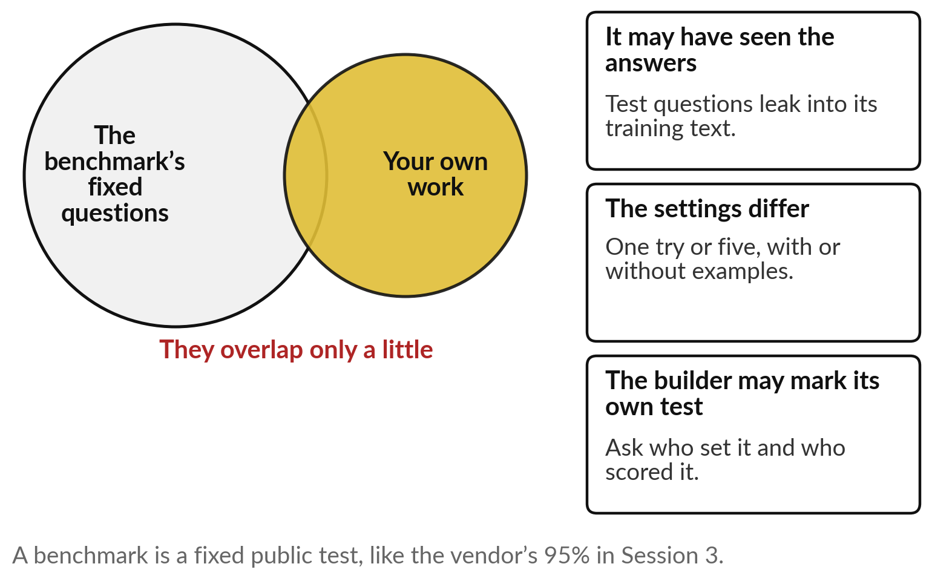
A benchmark is someone else’s test, so a high
score is a reason to test on your own work
The benchmark’s questions and your work overlap only a little.
Ask who set the test, and who scored it.
Ask for the settings.
Then test on ten of your own cases.
Notes:
That score comes from a benchmark, a fixed public test with an answer key. Its score is a headline number, like the vendor’s 95 per cent in Session 3: true on its own questions, and untested on yours. Your work is a different circle, and the two overlap only a little.
Three cautions. The model may have seen the answers, because test questions leak onto the web and into the text it learned from. The settings differ: one try or five, with or without examples, and the same model can score very differently. And the builder may set and mark its own test.
Treat a high score as a reason to run your own test on ten cases from your own work, as we do in the demonstration.

Slide 20
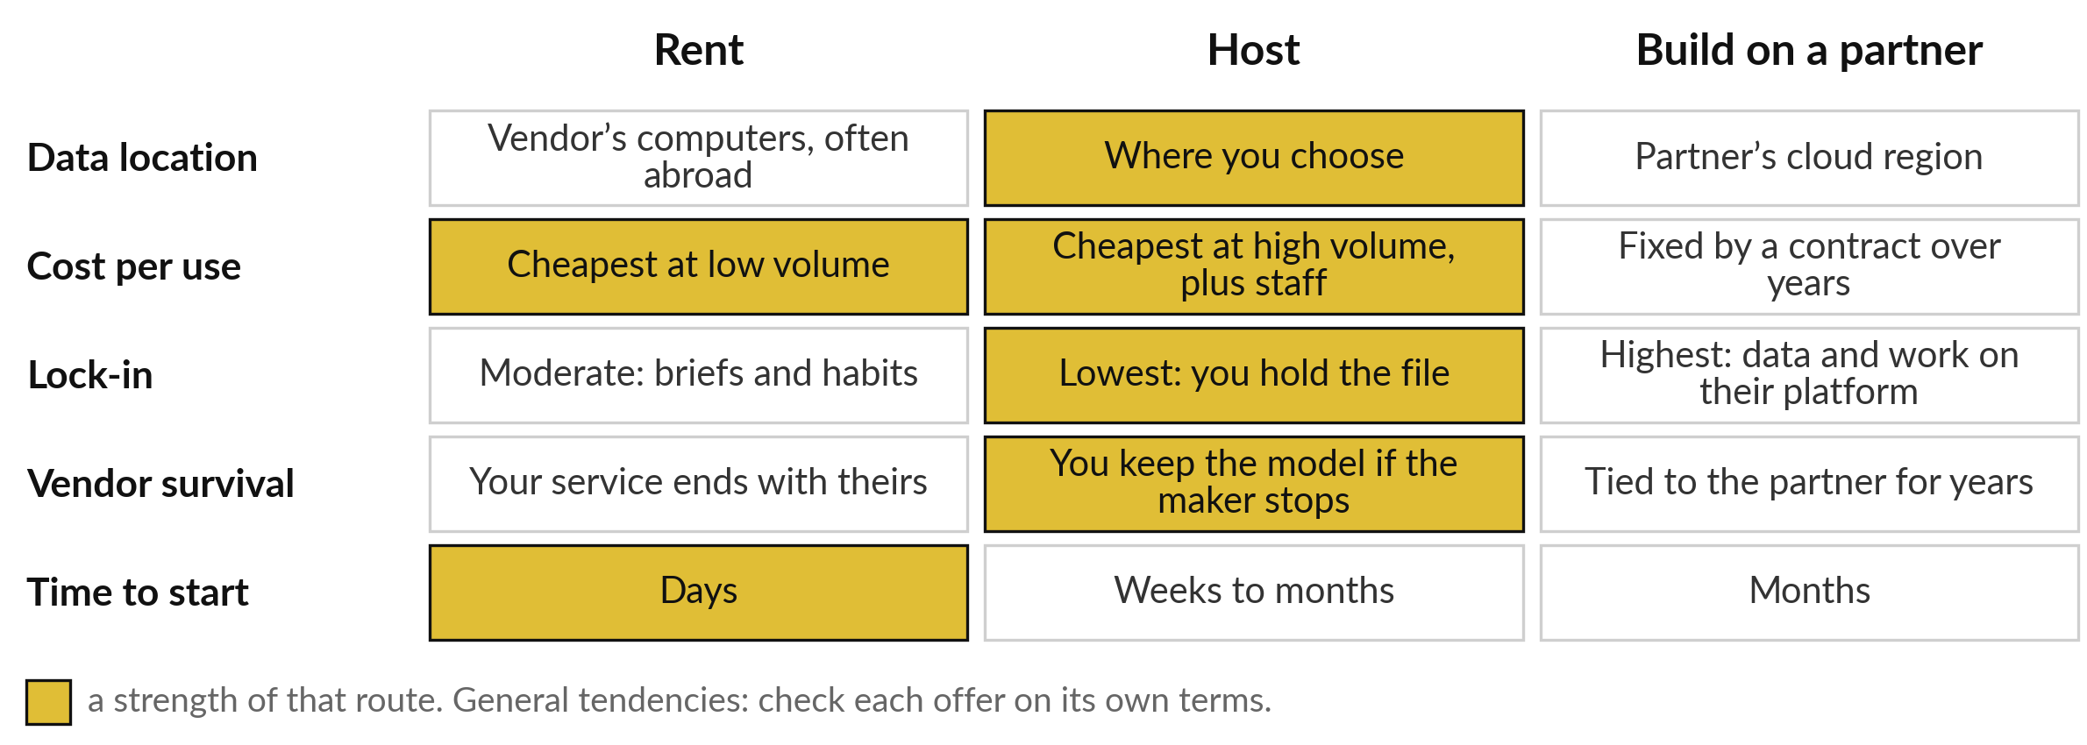
No route wins on every question,
so choose one for each use
General tendencies only: check every real offer on its own terms.
Notes:
Put together, the four questions give you this grid. A gold cell shows a strength of that route. Renting is quick to start, days rather than months, and cheapest at low volume; its data usually sits abroad, and your service ends if the vendor’s does. Hosting keeps the data where you choose, has the least lock-in because you hold the file, and you keep the model if its maker stops; it pays at high volume, once you count the staff.
Building on a partner can be powerful, and it ties your data and your work to that partner for years. These are general tendencies, and every real offer needs checking on its own terms.

Slide 21
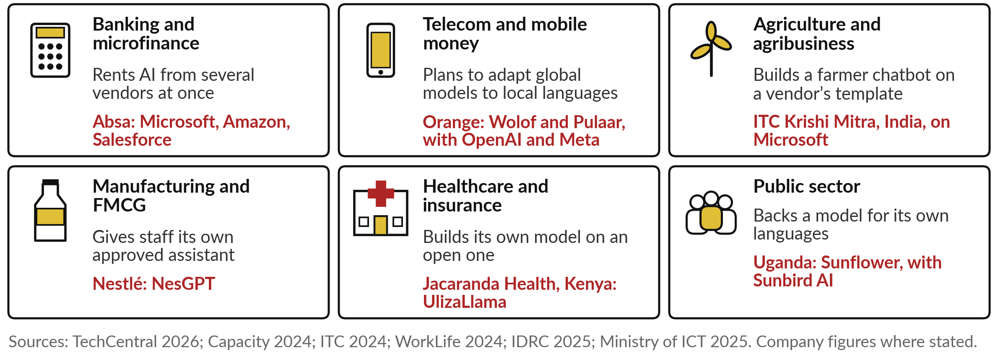
Absa rents from three vendors, Jacaranda built
its own model, and Uganda backs Sunflower
Orange’s Wolof and Pulaar models are plans; the others are in use.
Notes:
Organisations in your industries have chosen differently. In banking, Absa rents AI from several vendors at once. In telecom, Orange, as Session 4 mentioned, plans to adapt OpenAI’s and Meta’s models to Wolof and Pulaar for customer support; those are plans. In agribusiness, ITC in India built its farmer chatbot on a template from Microsoft.
In FMCG, Nestlé gave its office staff an approved assistant of its own, NesGPT. In health, Jacaranda built a Kiswahili model on an open one. And in the public sector, Uganda’s Ministry of ICT launched Sunflower with Sunbird AI, a model for Ugandan languages. Find your own industry’s tile; we look closer at Sunflower, Jacaranda and Babyl Rwanda.

Slide 22
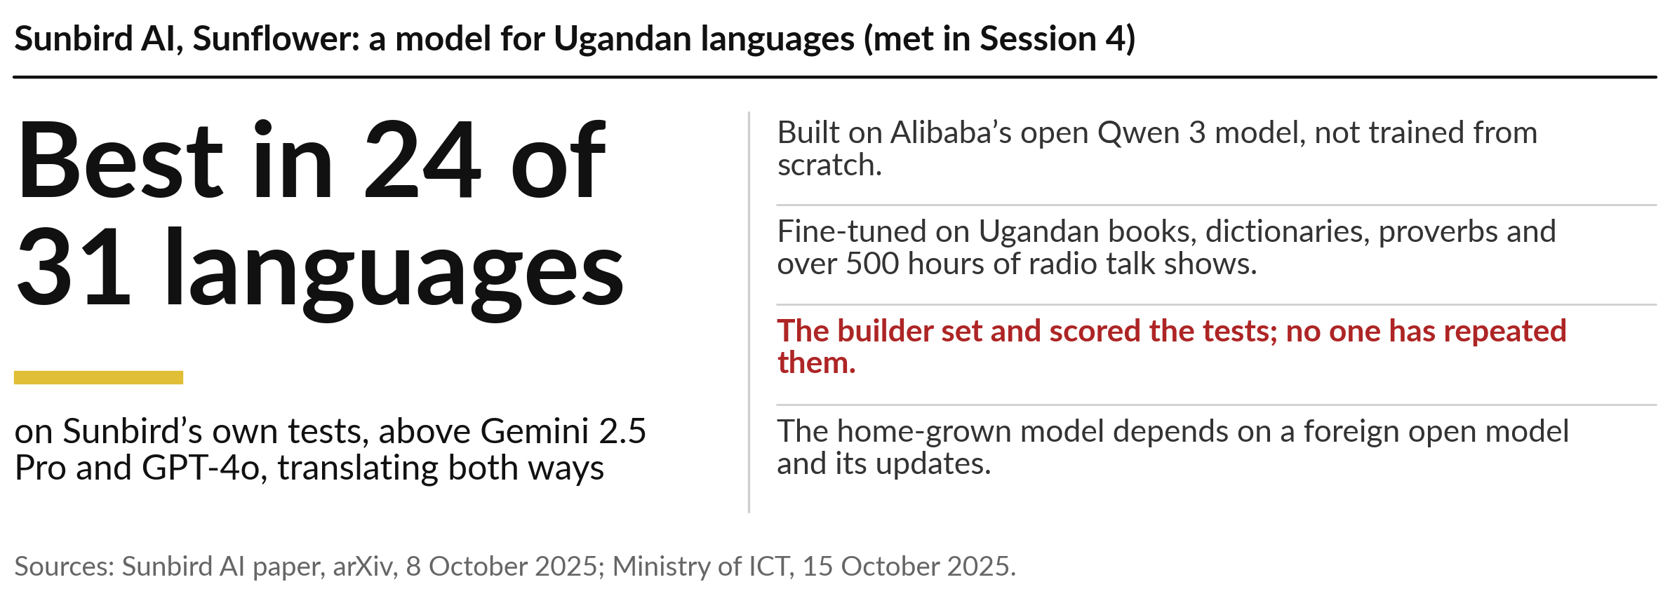
Sunbird adapted an open model for Ugandan
languages, and scored it on its own tests
Notes:
You met Sunflower in Session 4 as a language tool. Today read it as a buying decision. Sunbird AI did not train a model from scratch, which would need vast computers and far more Ugandan text than exists. It took Alibaba’s open Qwen 3 model and fine-tuned it on Ugandan books, dictionaries and proverbs, and on more than 500 hours of radio talk shows.
The result is the one you saw in Session 4: best in 24 of 31 languages on Sunbird’s own tests. Apply today’s two lessons. The builder set and scored the test, and no one has repeated it, so this benchmark is the seller’s own. And a home-grown model built on a foreign open model raises a sovereignty question: whose model and whose updates do we depend on?

Slide 23
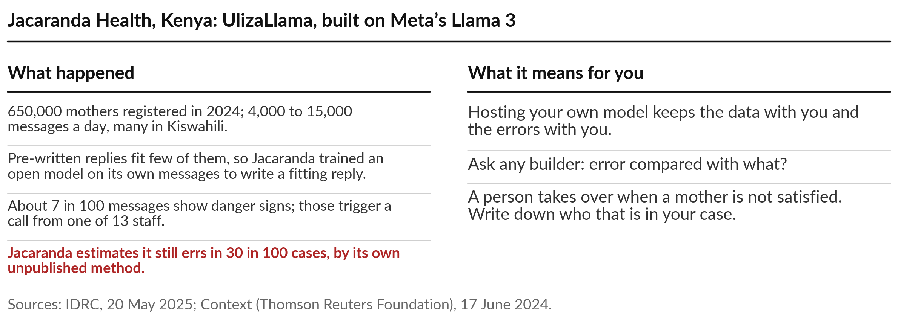
Jacaranda Health built its own Kiswahili model
for mothers’ questions, and owns its errors too
Notes:
The second story puts an open model in the builder’s own hands. Jacaranda Health, whose text-message service you met in Session 2, runs it for pregnant women and new mothers in Kenya. In 2024, 650,000 mothers were registered, and 4,000 to 15,000 messages arrive each day, many in Kiswahili.
Pre-written replies fit few of them. So Jacaranda built its own open model, UlizaLlama, on Meta’s Llama 3, trained on its own messages, to write a fitting reply. About 7 in 100 messages show danger signs, and those trigger a call from one of 13 staff. Jacaranda itself estimates the service still errs in 30 in 100 cases, by a method it has not published, so ask: error compared with what? A person takes over whenever a mother is not satisfied.

Slide 24
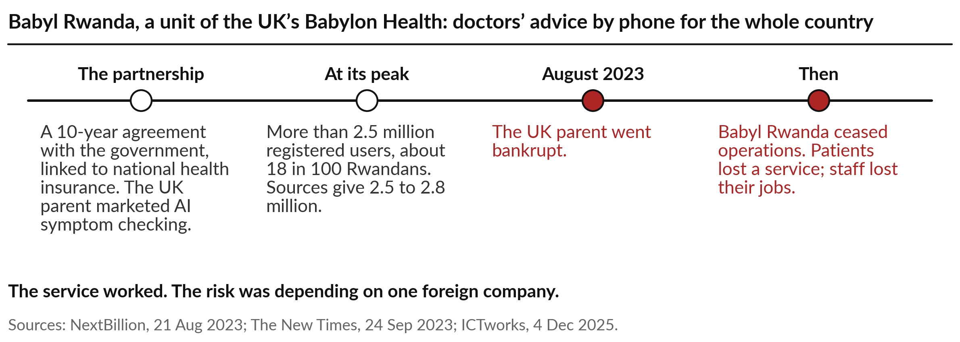
Babyl Rwanda reached 2.5 million users,
then closed when its UK parent failed
Notes:
The third story is about vendor survival, and it ends badly. Rwanda wanted doctors’ advice by phone for the whole country, linked to national health insurance. Babyl, the Rwandan unit of the UK company Babylon Health, ran that service under a ten-year partnership with the government. Its UK parent marketed AI symptom checking, though the sources do not describe AI triage in the Rwandan service, which was mainly phone consultations.
More than 2.5 million people registered, about 18 in every 100 Rwandans. Then the parent company’s finances collapsed, it went bankrupt in August 2023, and Babyl Rwanda ceased operations. Patients lost a service and local staff lost their jobs. Nothing was wrong with the idea. The risk was depending on one foreign company.

Slide 25
One customer complaint, given to two
assistants and scored on five checks
I will show
Watch for
A shop owner’s complaint: 3 of 20 bags arrived wet, paid UGX 1,560,000 by MoMo.
Claude, hosted, one run; a small open model on a laptop, three runs.
Promises the company never made
Whether the sum is right
Whether it says what it cannot confirm
Notes:
The benchmark slide said run your own test, and this one was recorded on 6 November 2026. A shop owner writes that 3 of 20 bags of maize flour arrived wet and torn, says they paid UGX 1,560,000 by MoMo, and asks what we will do and when.
Both assistants got the same text, with three jobs: label the message, check the sum, and reply in at most 70 words without promising anything the company has not said. One is a hosted assistant, Claude, in a fresh session, one run. The other is a small open model, Qwen two point five with 1.5 billion learned numbers, run three times on a laptop. To be fair, it is far smaller than any hosted assistant.

Slide 26
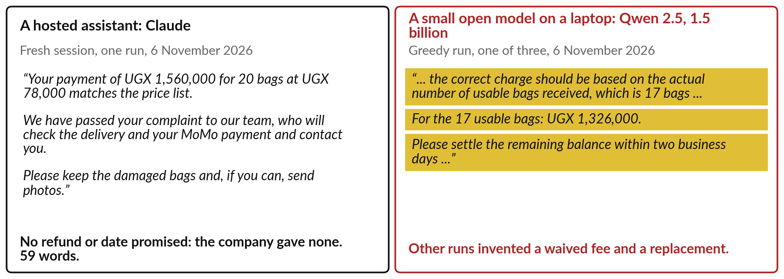
The hosted assistant kept to the facts;
the small open model invented a policy
Gold: what the company never said. Recorded runs, 6 November 2026.
Notes:
Read the two replies before I say anything. On the left, Claude confirmed that UGX 1,560,000 matches 20 bags at UGX 78,000, said the complaint was passed to the team, and asked the shop owner to keep the bags and send photos. It promised no refund and no date, because the company had given none, in 59 words.
On the right, the small model got the sum right, then invented a policy: charge only for 17 usable bags, and settle the balance in two days, though the shop had already paid. Its other two runs invented a waived shipping fee and a replacement. That is Session 5 at work: likely words, with nothing checking them against what the company said.

Slide 27
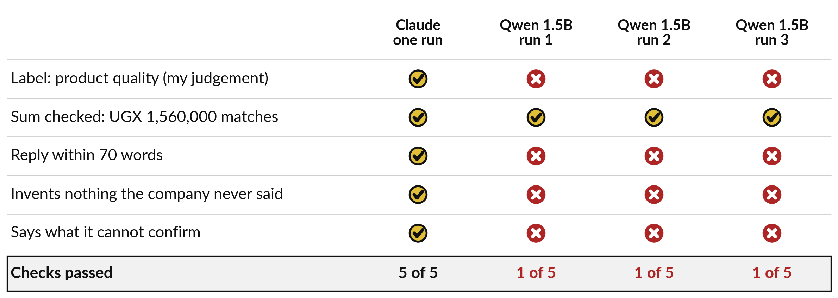
The hosted assistant passed all five checks;
the small model passed one in every run
One task proves nothing about products in general. It shows what your own test looks like.
Notes:
To be fair to both, I scored them on the same five checks, my own judgement. Claude passed all five. The small model got the sum right in every run, and nothing else. It labelled the message billing, which is defensible since a payment is mentioned, so treat that row as my call.
Its replies ran to about 90 to 120 words against a limit of 70, it invented something in every run, and it never said what it could not confirm. Be careful with the lesson. A hosted assistant of unpublished size against a small laptop model is an unequal match.
What it shows is the method: one real task, an answer key, five checks, counted. You can run that on any vendor’s offer.

Slide 28
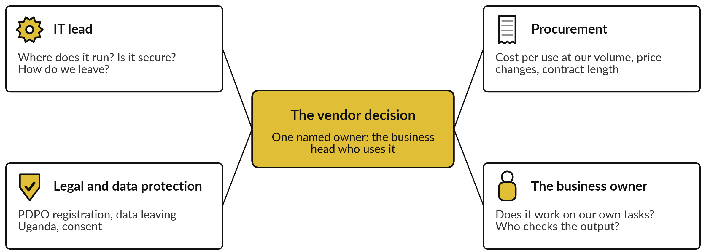
IT, procurement and legal sit at one table,
and one named person owns each vendor
Babyl Rwanda’s staff and patients carried the cost of one vendor’s failure.
Notes:
That method needs people. A vendor decision is no longer an IT purchase alone, and four people belong at the table. The IT lead asks where it runs, whether it is secure and how we would leave. Procurement asks the cost per use at our volume, how prices can change and how long the contract binds us.
Legal and the data protection officer ask about PDPO registration, data leaving Uganda and consent. And the business owner asks whether it works on our own tasks and who checks the output. One named person owns the vendor relationship, usually the business head who uses it. When a vendor fails, your staff and customers carry the cost.
Who sits at that table in your organisation today?

Slide 29
Six things to ask a vendor before you sign,
from the model underneath to the exit
Ask | Why it matters
Which model is underneath, and who made it? | Many products sit on another maker’s model
Where is our data stored and used, and are you registered with the PDPO? | Uganda’s law follows the data
What does each use cost at our volume, and how can prices change? | Renting grows with every request
How do we leave, and in what format do we get our data back? | Lock-in is cheapest to fix before you sign
What happens to our service if you are bought or close? | Babyl Rwanda’s users found out
What was the score on a sample of our own work? | A benchmark is someone else’s test
Notes:
The whole session fits in six questions, one per row. Ask which model is underneath and who made it, because many products sit on another maker’s model. Ask where your data is stored and used, and whether they are registered with the PDPO. Ask what each use costs at your volume and how prices can change.
Ask how you would leave, and in what format your data comes back. Ask what happens to your service if they are bought or close. And ask for a score on a sample of your own work, because a benchmark is someone else’s test. You can put all six to a vendor next week.

Slide 30
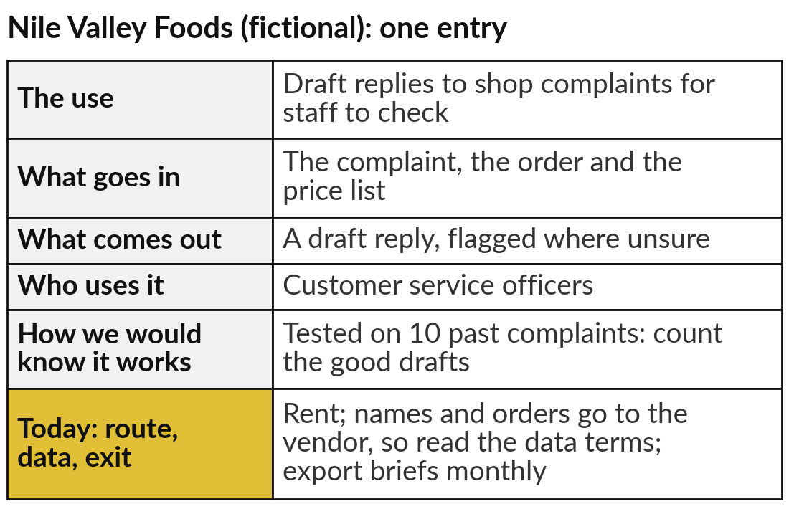
Choose a route for each entry
in your AI Opportunity Portfolio
25 minutes
Hands-on: your portfolio
For each entry, choose rent, host or build on a partner, and say why.
Note what data each use touches.
Estimate the monthly volume.
Choose the route, using the four questions.
Write how you would leave.
You keep: Each portfolio entry with its route, data note and exit plan.
Notes:
For twenty-five minutes you work on your own organisation, and I walk round. Open your AI Opportunity Portfolio. For each entry from Sessions 1 to 5, add today’s column. First note what data the use touches: public text, customer names, salaries or health records. Then estimate the monthly volume, even roughly.
Then choose rent, host or build on a partner, using the four questions, and write one sentence of reason. Finally, write how you would leave. The example on the right is for Nile Valley Foods, our fictional distributor: drafts of replies to shop complaints, rented, with a note that names and orders go to the vendor, so someone reads the data terms. If an entry needs a lawyer’s view, write that down too.

Slide 31




Which route would you take for your first
AI use, and what would change your mind?
For the entry you would start with, which route, and what would make you switch?
Rent
Host
Partner
Wait
Quick to start; read the data terms and plan the exit
Data stays where we choose; we have the volume and the people
Our data platform moves to a big cloud for years
Our data, law or volume is not yet clear
Write your decision and the reason in your workbook.
Notes:
With your routes written, one decision. For the entry you would start with, which route?
Rent, if speed matters and the data terms pass your lawyer; plan the exit anyway. Host, if the data must stay where you choose and you have the volume and the people to run it. Build on a partner, if your whole data platform is moving to a big cloud and you accept being tied to it for years.
Or wait, if your data, the law or your volume is not yet clear. That is a sound answer, and your first step becomes finding out. Then write the one thing that would change your mind: a price rise, a ruling, or the vendor being bought. I will take a few choices and triggers before we close.

Slide 32
Choose the route use by use, and test
any supplier on your own work first
Rent, host or build on a partner: four questions decide.
Most local builders start from an open model.
Uganda’s law follows your data abroad.
Our test: one task, five checks, counted.
Notes:
Take these four questions with you; they are the session. Behind any chatbot is a maker: a global lab, an open-weights maker or a local builder, and most local builders start from an open model. The model runs on their computers, or you take the file to yours.
That gives three routes: rent a hosted assistant, host an open model, or build on a partner’s platform. The four questions choose between them: where the data goes and what Uganda’s law says, cost per use, lock-in and vendor survival. And test it yourself, because a benchmark is someone else’s test; ours took one task and five checks.

Slide 33
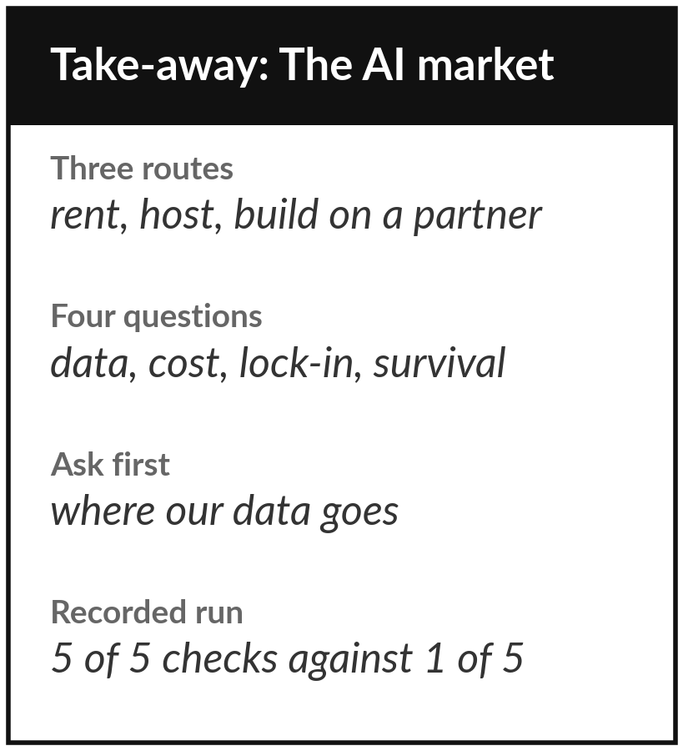
Keep the sheet, and the route you
chose for each portfolio entry
What you keep from today
A one-page sheet: the three routes, the four questions, the vendor questions, today’s recorded comparison, and the route for each portfolio entry.
Our question today
Which model and supplier, where does our data go, and what will it cost to run?
Next session
Session 7: Getting good work from AI assistants: prompting for leaders and teams.
Notes:
Keep the take-away sheet. It has the three routes, the four questions, the vendor questions, and today’s recorded test: the hosted assistant passed 5 of 5 checks, the small open model 1 of 5 in each of three runs, on one task. Your portfolio now says, for each entry, which route, where the data goes and how you would leave.
In Session 7 we take the tool you chose and learn to brief it well, because the same assistant gives very different work to a weak brief and a strong one.
We began with this question: Which model and supplier, where does our data go, and what will it cost to run? Before you go, say in one sentence what you can now say about it.

